Slide 1
CluedIn AI training: AI enricher
Filling gaps, adding context, and transforming incomplete records into trusted, enriched data

Slide 2
Training agenda
Learn about the concept of AI enricher in Cluedin
Go through the advantages the AI enricher offers
Explore real-life examples of using AI enricher

Slide 3
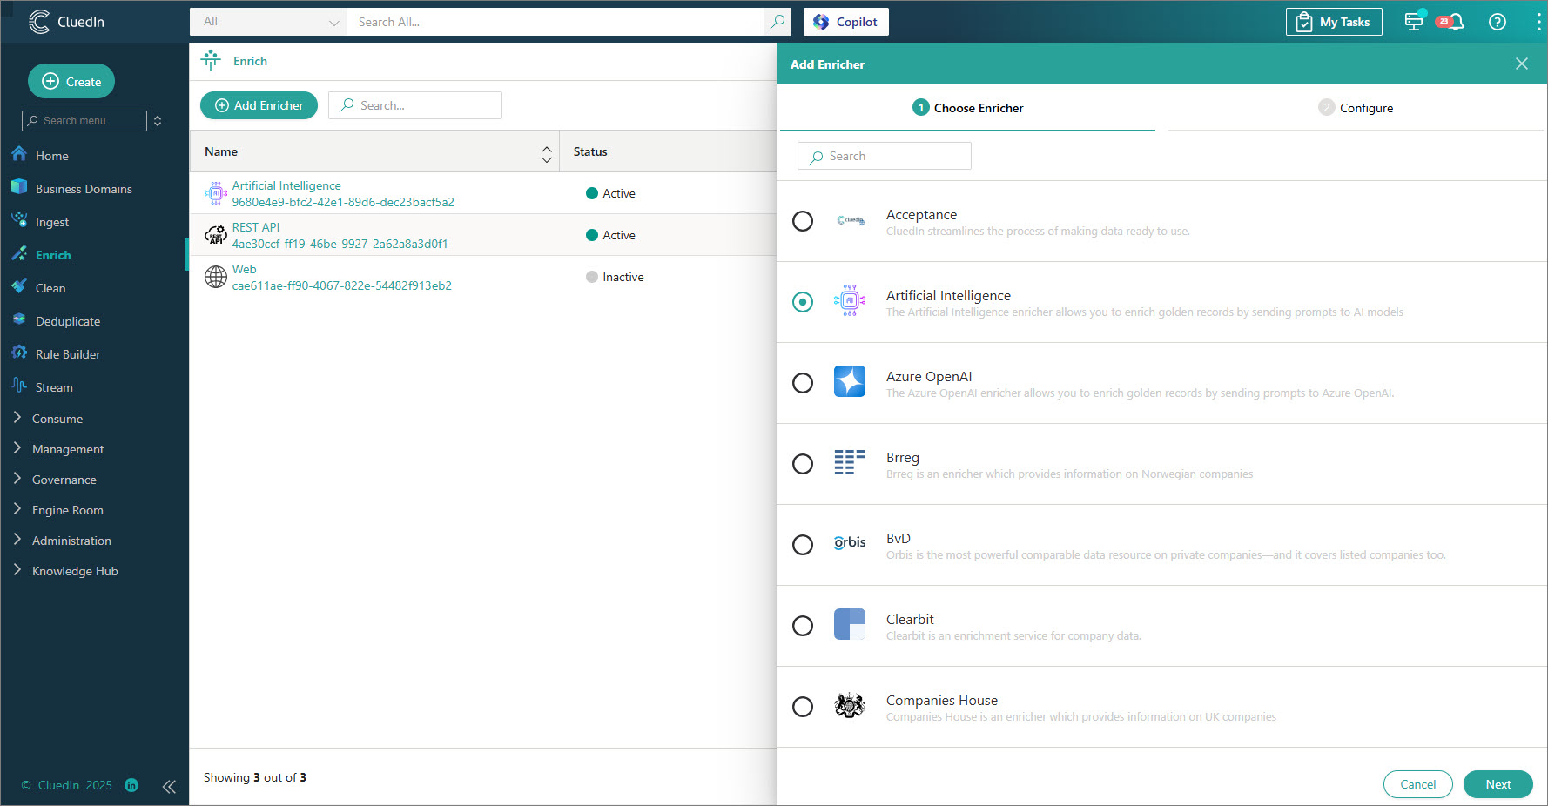

AI enricher in CluedIn
Enrichers allow you to enhance and improve the quality and completeness of your golden records by incorporating additional information from third-party sources.
AI enricher leverages the capabilities of artificial intelligence and large language models (LLMs) to automate data enrichment. It intelligently researches, interprets, and completes your records, providing up-to-date insights while significantly reducing the need for manual effort.

Slide 4
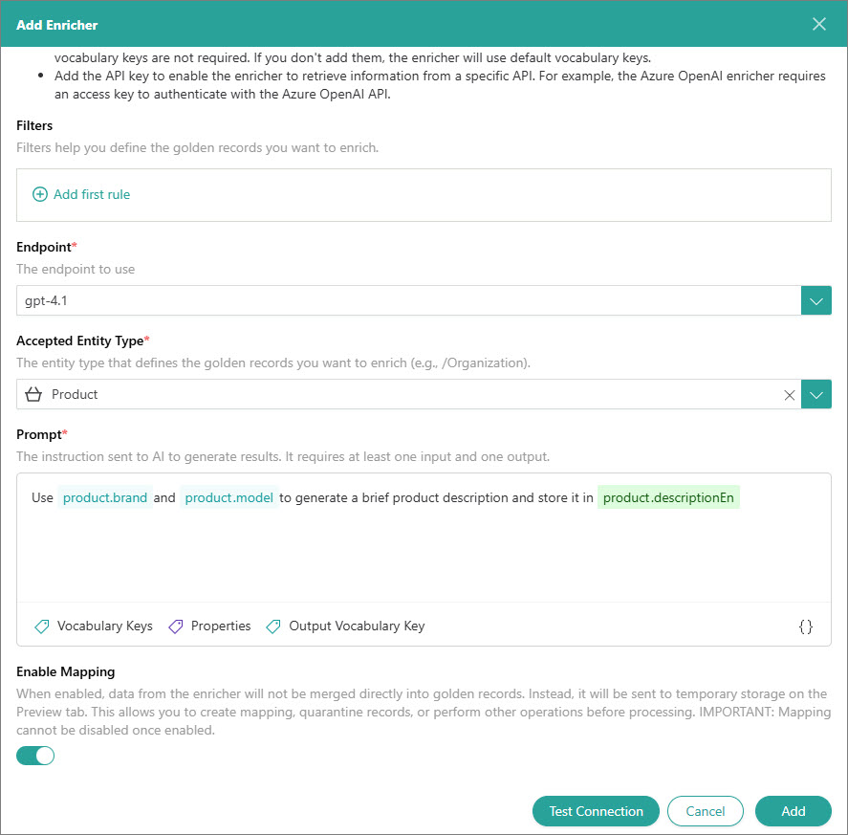
Flexible enrichment with context-aware intelligence
Use natural-language prompts to guide the enricher.
Backed by LLMs, it understands your data’s context and can enrich it intelligently, even without explicit reference data.

Slide 5
#6B7280
NovaSound Echo Pro
BUSINESS DOMAIN: PRODUCT
Source: ERP
PRODUCT ID
P-2025
SKU
HPH-001
BRAND
NovaSound Technologies
PRICE
199.0
CURRENCY
USD

Slide 6

#6B7280
NovaSound Echo Pro
BUSINESS DOMAIN: PRODUCT
#6B7280
NovaSound Echo Pro
BUSINESS DOMAIN: PRODUCT
Source: ERP
PRODUCT ID
P-2025
Source: ERP
SKU
HPH-001
PRODUCT ID
P-2025
BRAND
NovaSound Technologies
SKU
ENRICHER
PRICE
HPH-001
AI
199.0
BRAND
NovaSound Technologies
CURRENCY
USD
PRICE
199.0
CURRENCY
Source: AI enricher
USD
DESCRIPTION
Wireless headphones with noise-canceling
CATEGORY
Audio

Slide 7
Examples of using AI enricher
Generate a summary or description based on a piece of text (e.g., a website summary based on its contents)
Fill missing descriptions or categories for products
Retrieve additional metadata (e.g., material type, brand, or supplier)
Use the organization’s address to identify the country of origin
Translate text (e.g., product descriptions) from one language into another
Suggests standardized terms for inconsistent product names

Slide 8
Examples of using AI enricher
Generate a summary or description based on a piece of text (e.g., a website summary based on its contents)
Fill missing descriptions or categories for products
Retrieve additional metadata (e.g., material type, brand, or supplier)
Use the organization’s address to identify the country of origin
Translate text (e.g., product descriptions) from one language into another
Suggests standardized terms for inconsistent product names

Slide 9
Examples of using AI enricher
Generate a summary or description based on a piece of text (e.g., a website summary based on its contents)
Fill missing descriptions or categories for products
Retrieve additional metadata (e.g., material type, brand, or supplier)
Use the organization’s address to identify the country of origin
Translate text (e.g., product descriptions) from one language into another
Suggests standardized terms for inconsistent product names

Slide 10
Examples of using AI enricher
Generate a summary or description based on a piece of text (e.g., a website summary based on its contents)
Fill missing descriptions or categories for products
Retrieve additional metadata (e.g., material type, brand, or supplier)
Use the organization’s address to identify the country of origin
Translate text (e.g., product descriptions) from one language into another
Suggests standardized terms for inconsistent product names

Slide 11
Examples of using AI enricher
Generate a summary or description based on a piece of text (e.g., a website summary based on its contents)
Fill missing descriptions or categories for products
Retrieve additional metadata (e.g., material type, brand, or supplier)
Use the organization’s address to identify the country of origin
Translate text (e.g., product descriptions) from one language into another
Suggests standardized terms for inconsistent product names

Slide 12
Examples of using AI enricher
Generate a summary or description based on a piece of text (e.g., a website summary based on its contents)
Fill missing descriptions or categories for products
Retrieve additional metadata (e.g., material type, brand, or supplier)
Use the organization’s address to identify the country of origin
Translate text (e.g., product descriptions) from one language into another
Suggests standardized terms for inconsistent product names

Slide 13


Key advantages of AI enricher
Broader scope
Unlike rule-based enrichers limited to fixed formats, the AI enricher handles diverse data, with adaptive intelligence and precision
Traditional enrichers
Designed for specific data types
Effective but limited to narrow, predefined domains

Slide 14
Key advantages of AI enricher
Broader scope
Unlike rule-based enrichers limited to fixed formats, the AI enricher handles diverse data, with adaptive intelligence and precision
Traditional enrichers
Designed for specific data types
Effective but limited to narrow, predefined domains
AI enricher
Works with any type of data
Learns patterns and relationships dynamically

Slide 15
Key advantages of AI enricher
Contextual understanding
AI enricher understands the meaning and context behind your data – enriching records intelligently, not just by rule
Traditional enrichers
Apply rules but do not understand what the data represents

Slide 16
Key advantages of AI enricher
Contextual understanding
AI enricher understands the meaning and context behind your data – enriching records intelligently, not just by rule
Traditional enrichers
Apply rules but do not understand what the data represents
AI enricher
Interprets data in context
Can recognize meaning behind data and determine related details

Slide 17
Key advantages of AI enricher
Flexibility and adaptability
AI enricher adapts to your data, ensuring continuous enrichment accuracy as your data landscape evolves
Traditional enrichers
Configured according to hard-coded rules
Tailored to narrow use cases (e.g., only addresses in Libpostal, or geolocation in Google Maps)

Slide 18
Key advantages of AI enricher
Flexibility and adaptability
AI enricher adapts to your data, ensuring continuous enrichment accuracy as your data landscape evolves
Traditional enrichers
Configured according to hard-coded rules
Tailored to narrow use cases (e.g., only addresses in Libpostal, or geolocation in Google Maps)
AI enricher
Accepts instructions in natural language
Can enrich any text-based content
Scales across data domains

Slide 19
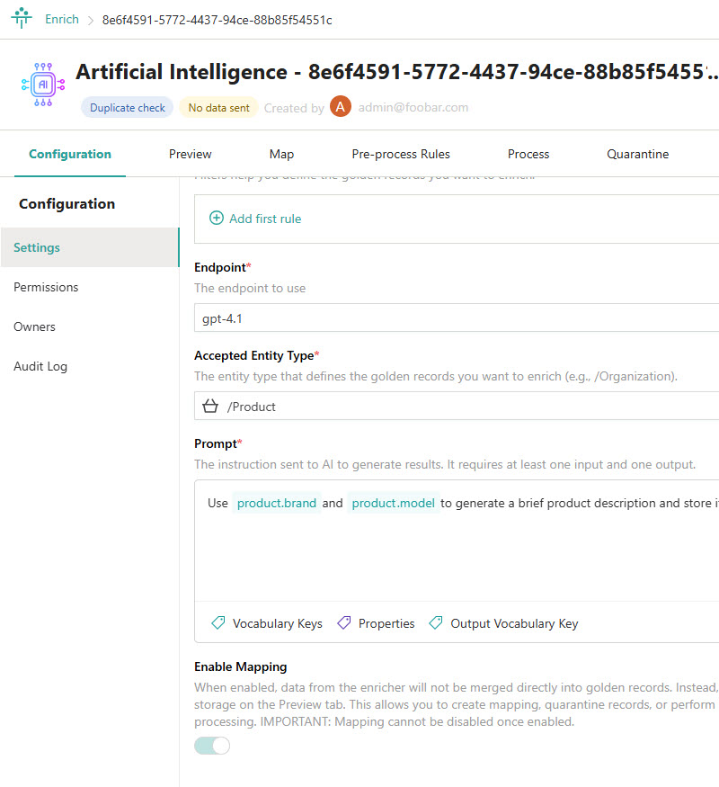



Learn more about AI enricher in our documentation portal.
Next session: Using AI enricher in practice to fill gaps in data.
What’s next?

